Slide 1
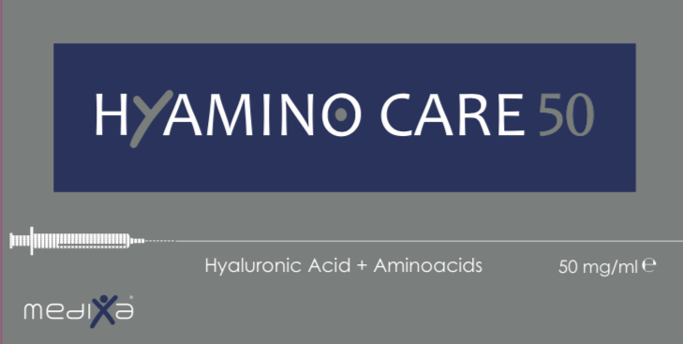
Medical Device Class III – CE 0373
Made in Italy

Slide 2
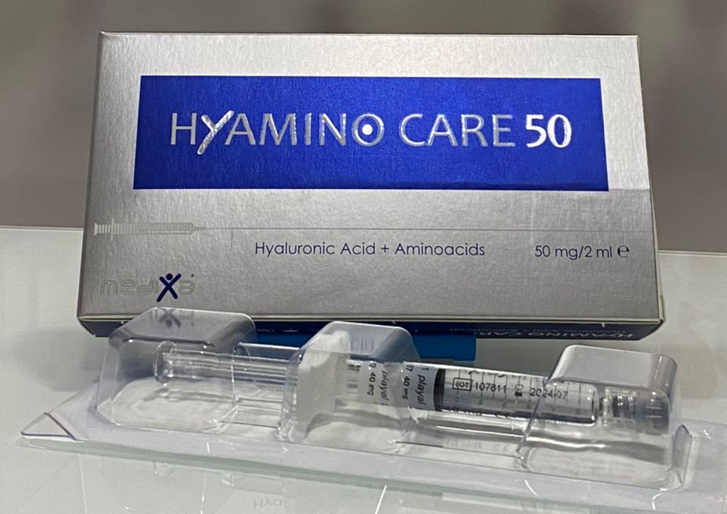
Innovative Bio-Restructuring
Medical Device Class III – CE 0373

Slide 3
HyaminoCare to Take Care of your skin
HyaminoCare50 has been developed and manufactured in Italy, thanks to our experience and with the support of the major Italian Research Centers, based on an innovative non cross-linked Hyaluronic Acid with additional 4 Amino acids in an optimal formula to preserve and to restore the physiological quality of the skin by promoting the conservation of its elasticity and protecting it against the natural crono-aging and external aggressions such as sun, cold and pollution.

Slide 4
HyaminoCare50 Formula

Slide 5
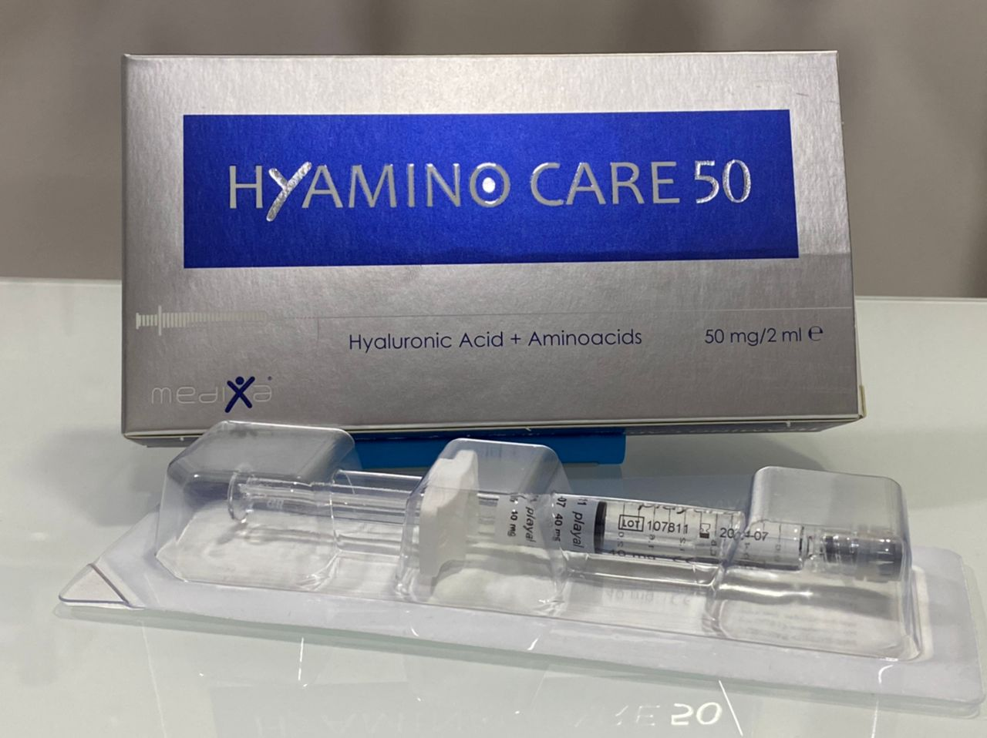
HyaminoCare HA 50mg/2ml
HyaminoCare50 is an innovative bio-restructuring product based on new generation hyaluronic acid 50mg/2ml with the combination of different amino acids (Lysine, Hydroxyproline, Proline and Glycine) to quickly repair and naturally regenerate the skin at all ages and for all skin types. Hyaminocare50 restores the basic structure of extracellular matrix (ECM) increases with biosynthetic capacity of fibroblasts by inducing the regeneration of an optimal physiological environment, enhancing cellular activities, hydration and collagen synthesis.

Slide 6
4 Amino-Acids of HyaminoCare50

Slide 7
PROLINE:
The aminoacid Proline is the main building block of the stabilizing proteins of collagen and elastin. More than 10% of the elementary particles of collagen molecules are composed of only proline.It is an important amino acid for the regeneration of the skin and tendon structures. The amino acid proline is a main component of the body's structural proteins, collagen and elastin.From one quarter to one third of the collagen reinforcement rods, for example, consist of proline.
L'aminoacido prolina è il principale elemento costitutivo delle proteine stabilizzanti del collagene ed elastina. Più del 10% delle particelle elementari delle molecole di collagene sono composte di sola prolina.
E’ un aminoacido importante per la rigenerazione della cute e delle strutture tendinee. L’aminoacido prolina è un principale componente delle proteine di struttura del corpo, collagene ed elastina.
Da un quarto ad un terzo delle aste di rinforzo di collagene, ad esempio, sono costituite da prolina.

Slide 8
HYDROXYPROLINE:
Heterocyclic amino acid constitutes with proline, the main component of collagen. Hydroxyproline differs from proline in the presence of a hydroxyl (OH) group attached to the C (gamma) atom. Hydroxyproline is an important component of the collagen protein, together with proline they play the key roles for collagen stability allowing the marked twisting of the fiber helix.
Aminoacido eterociclico costituisce con la prolina, il principale componente del collagene. L'idrossiprolina differisce da prolina dalla presenza di un gruppo dell'idrossile (OH) fissato all'atomo di C (gamma). L'idrossiprolina è un componente importante della proteina collagenica, assieme alla prolina svolgono i ruoli chiave per stabilità del collagene consentendo il torcimento marcato dell'elica della fibra.

Slide 9
GLYCINE:
is a non essen-tial amino acid found in most small amount of protein or tendons and muscles. It constitutes 30% of the structure of collagen. It is required to build the protein in the body and in the synthesis of nucleic acids, the con- struction of RNA, DNA and other amino acids of the body.
È un aminoacido non essenziale presente in piccola quantità̀ nella stragrande maggioranza delle proteine che si trovano nei tendini e nei muscoli; costituisce circa un terzo della struttura del collagene.
La glicina è richiesta per costruire la proteina nel corpo e nella sintesi degli acidi nucleici, la costruzione di RNA, il DNA, ed altri amminoacidi nel corpo.

Slide 10
LYSINE:
is an essential amino acid, it cannot synthesize naturally from the human body but it can be found mainly in foods that provide pro- teins of animal origin. It produces L-Carnitine, promotes bone growth and formation of cartilages and helps calcium absorption.
La lisina è un aminoacido essenziale, (il corpo umano non è in grado di sintetizzarla, per cui non può che essere ingerita già precostituita con il cibo). La lisina è presente soprattutto negli alimenti che forniscono proteine di origine animale.
Infatti inibisce la crescita dei virus, produce L-Carnitina la quale migliora la tolleranza allo stress, il metabolismo dei grassi ed ha un effetto anti- fatica, promuove la crescita ossea aiutando la formazione di collagene, la proteina fibrosa la quale costituisce le ossa, le cartilagini e altri tessuti connettivi - aiuta l’assorbimento del calcio.

Slide 11
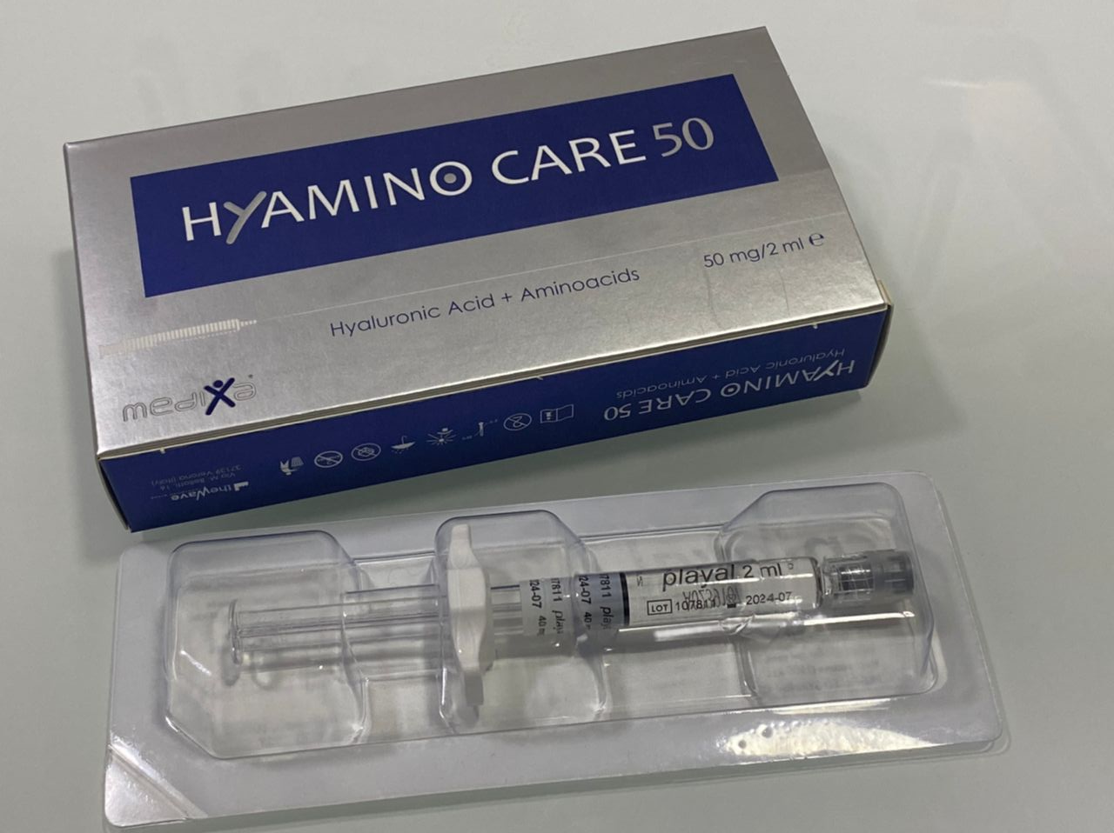
Characteristics
Medical Device Class III
Box: 2 syringe x 2 ml. Sterilization: Aseptic filtration
Pyrogen free
Ready to Use Conservation condition: 2°C to 25°C

Slide 12
Treatment techniques and areas of use
Treatment techniques
Fan Tecnique
Cross-hatching Tecnique
Retrotracing
Nappage
Point by point
Areas of use
Face
Neck
Decollete
Hands

Slide 13
PROTOCOL
Recommended Protocol: 3 sessions with 3 weeks intervals, then maintenance of the results by 1 session every 3 months. Protocol and concentration can be adapted depending on the maturity of the skin.
Treatmentt area: middle dermis or superficial dermis of the of theface, the neck, the hands and the décolleté.
3 weeks
3 weeks
3 months

Slide 14
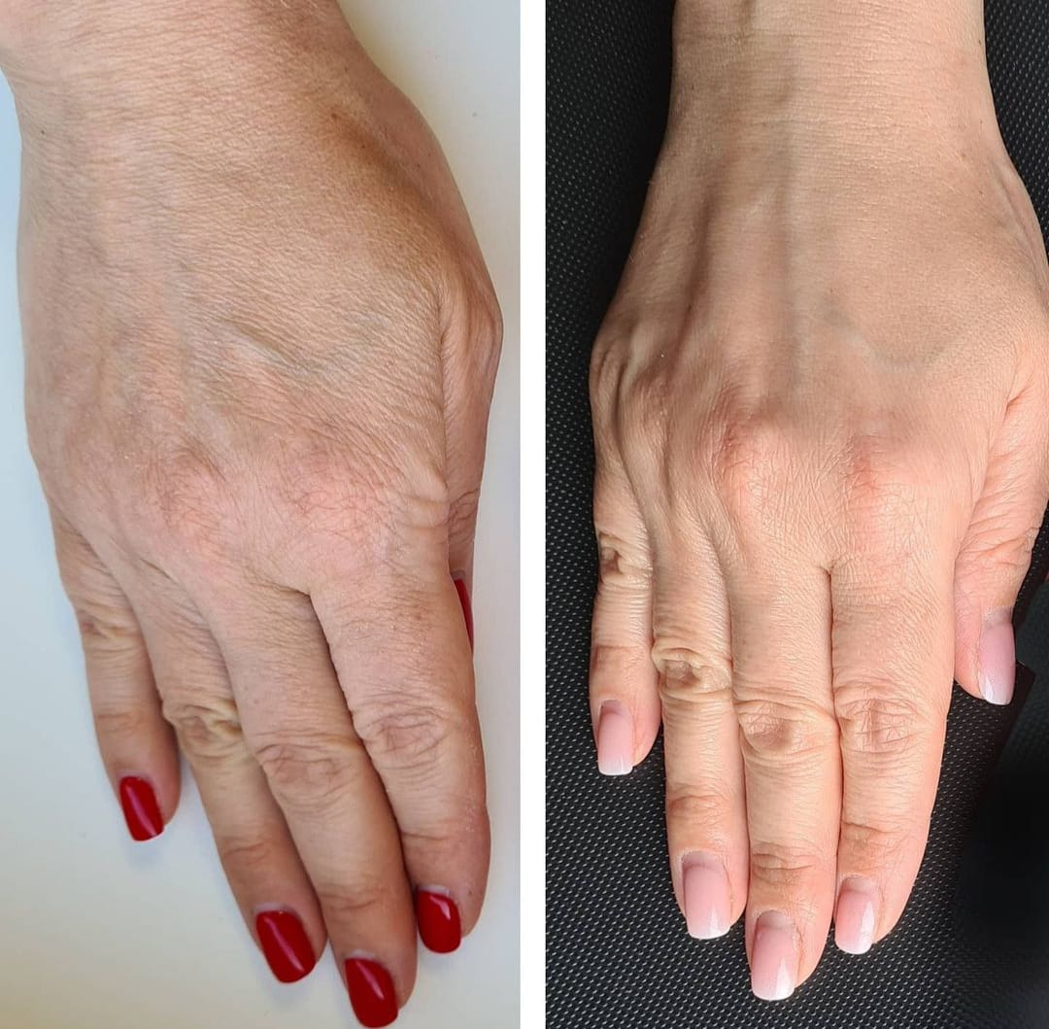
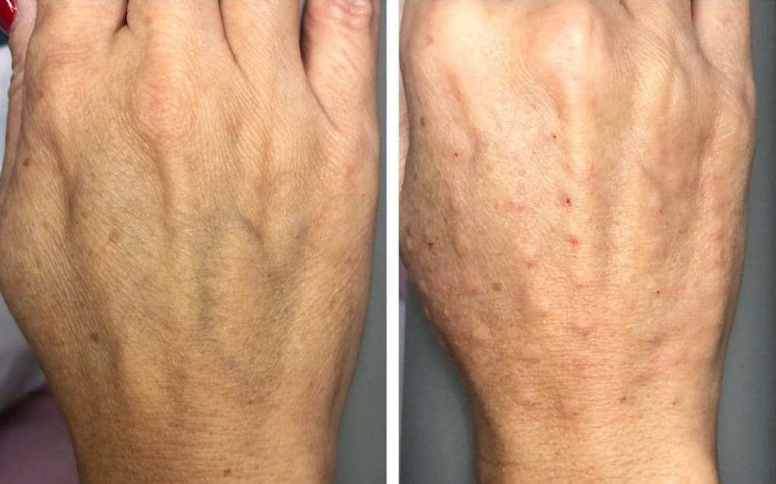
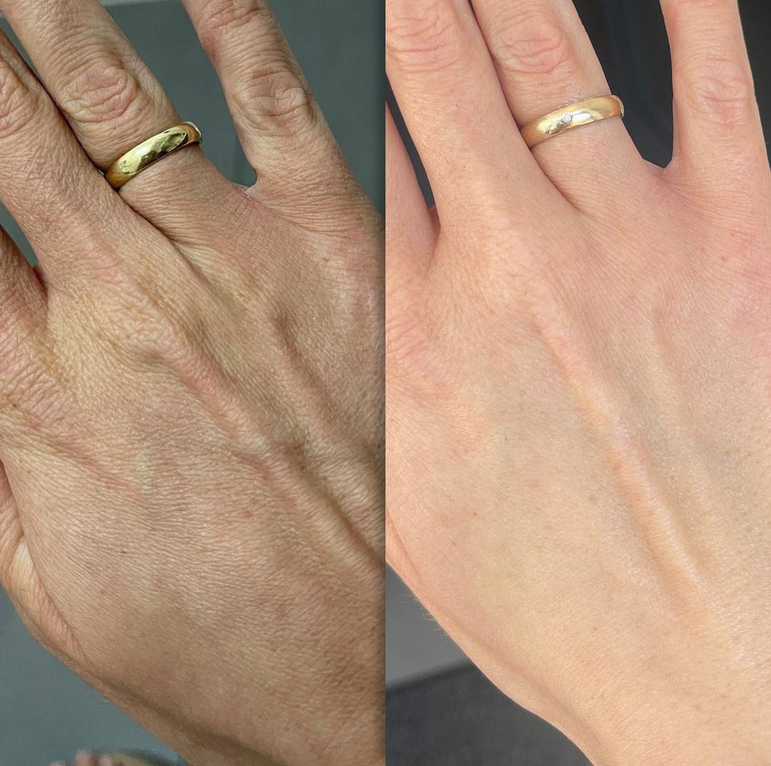
Post treatement results
Dr. Agata Nazdrowicz from Lodz - Poland

Slide 15
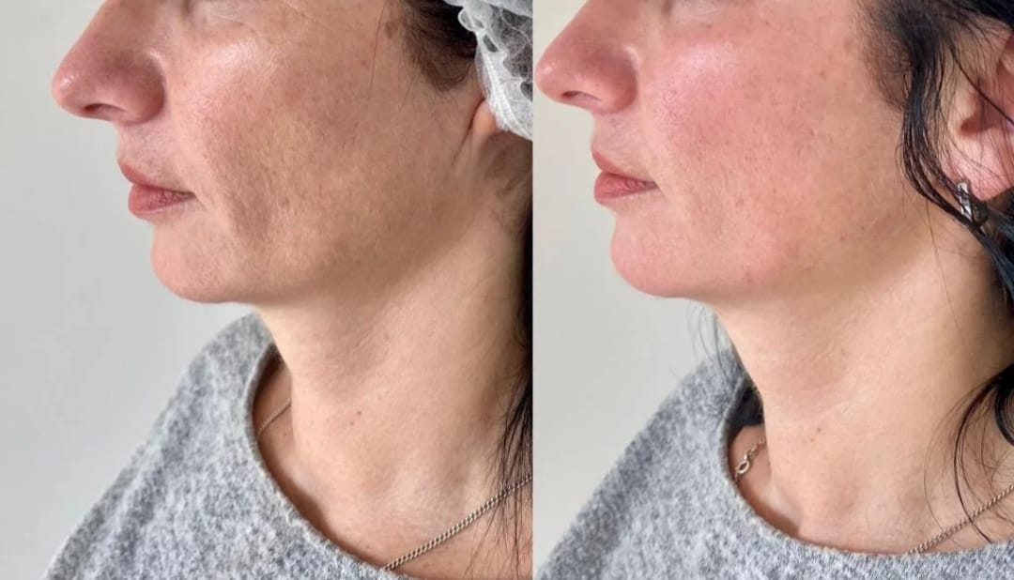
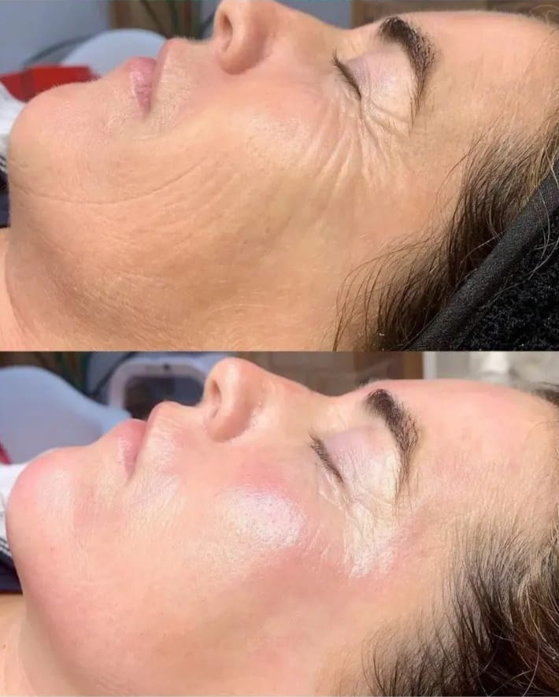
Post treatement results
Dr. Agata Nazdrowicz from Lodz - Poland

Slide 16
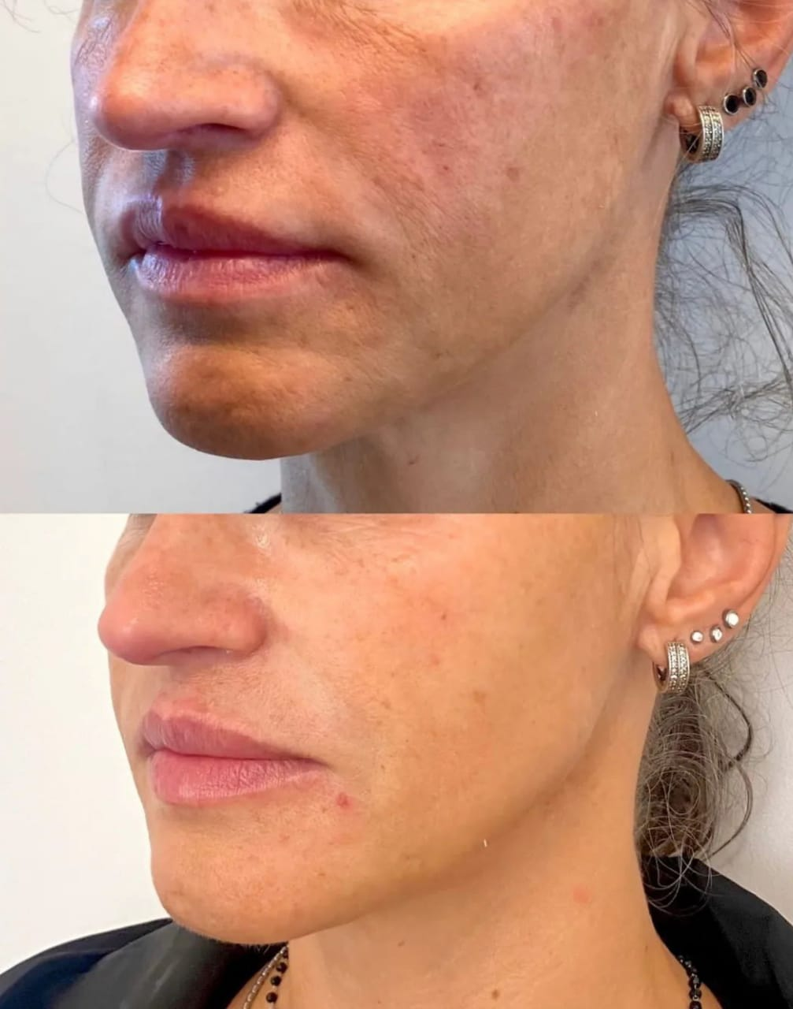
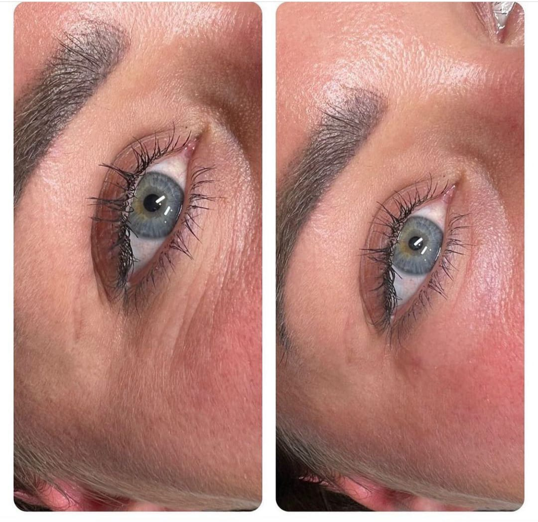
Post treatement results
Dr. Agata Nazdrowicz from Lodz - Poland

Slide 17
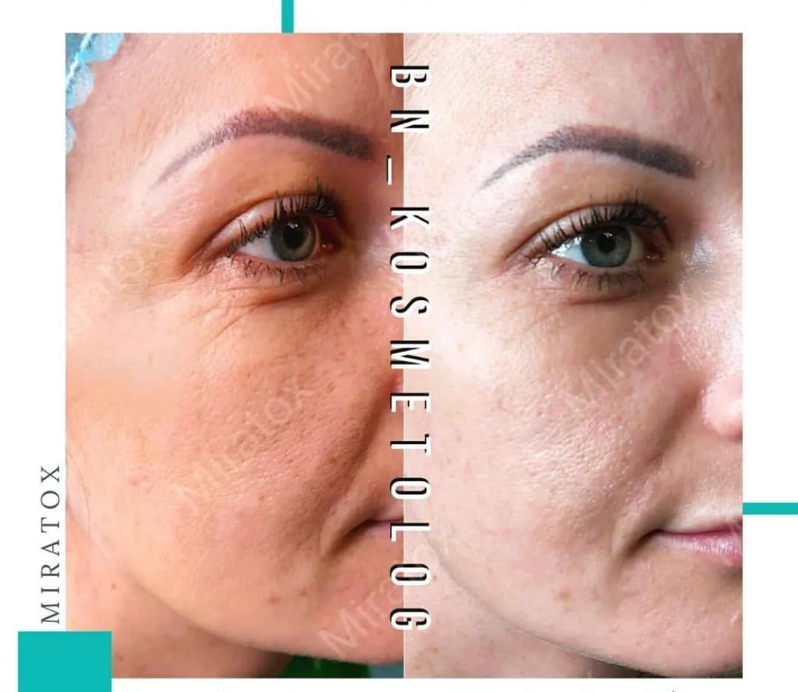
Post treatement results

Slide 18
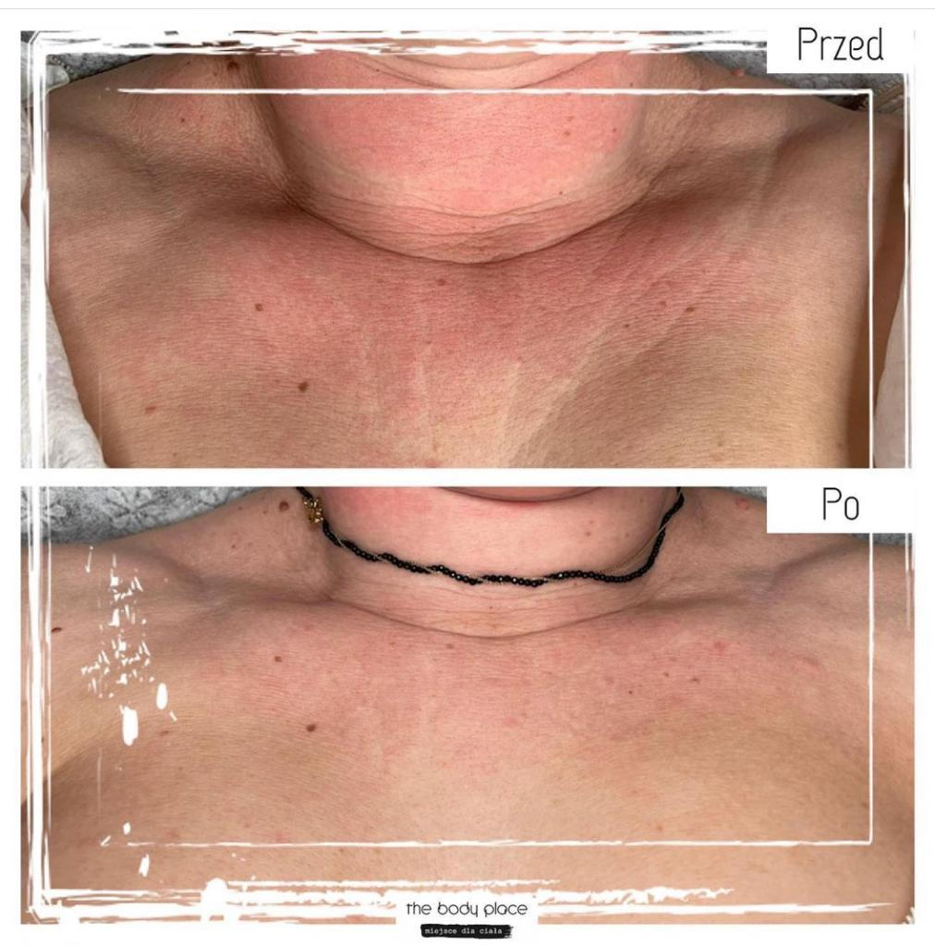
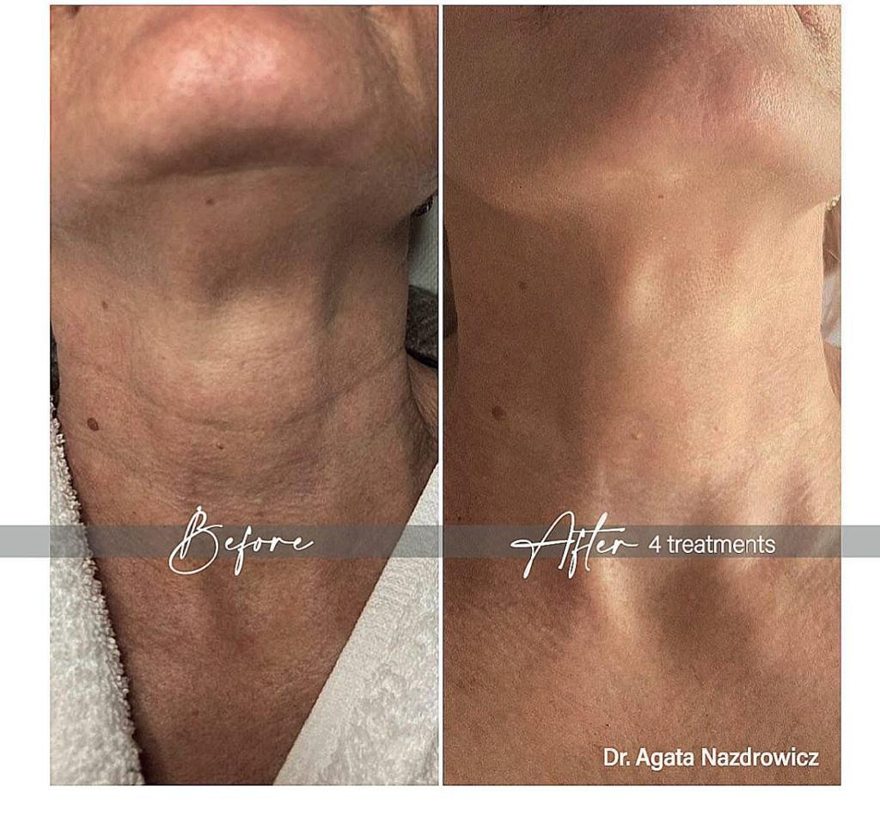
Post treatement results

Slide 19
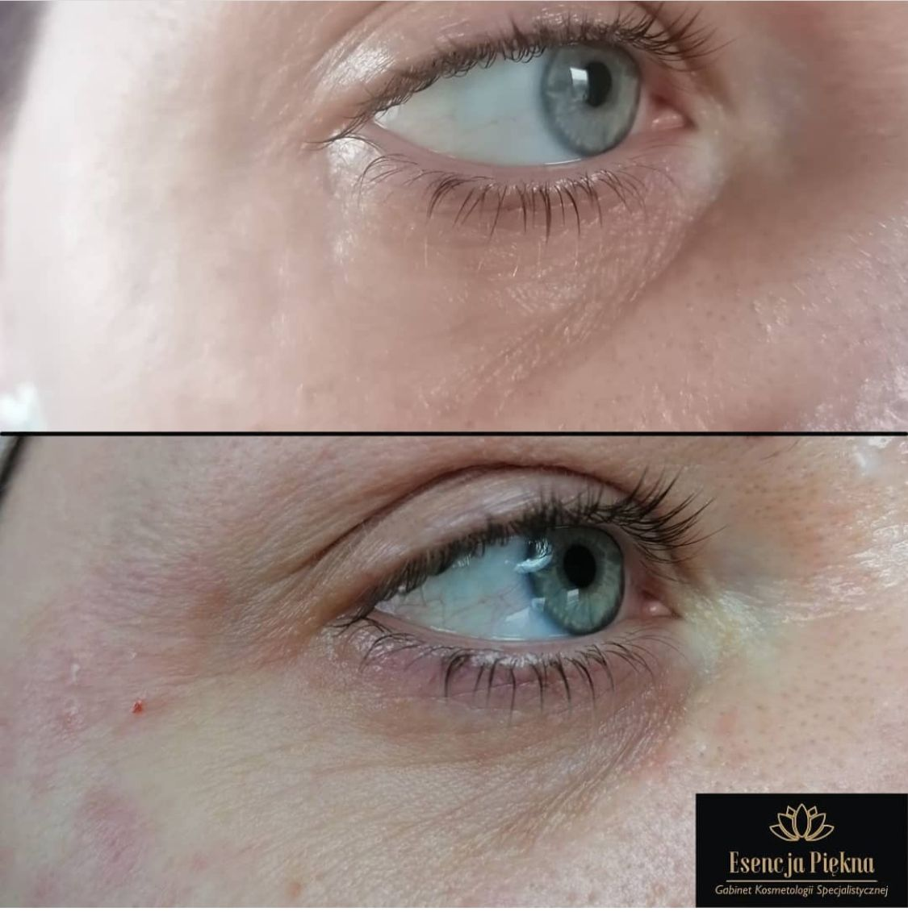
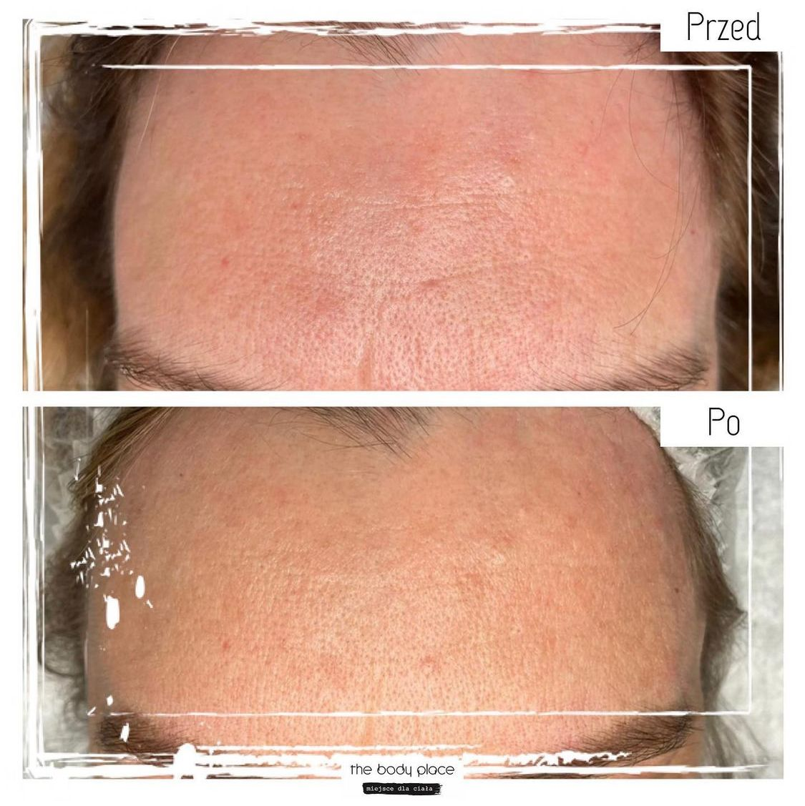
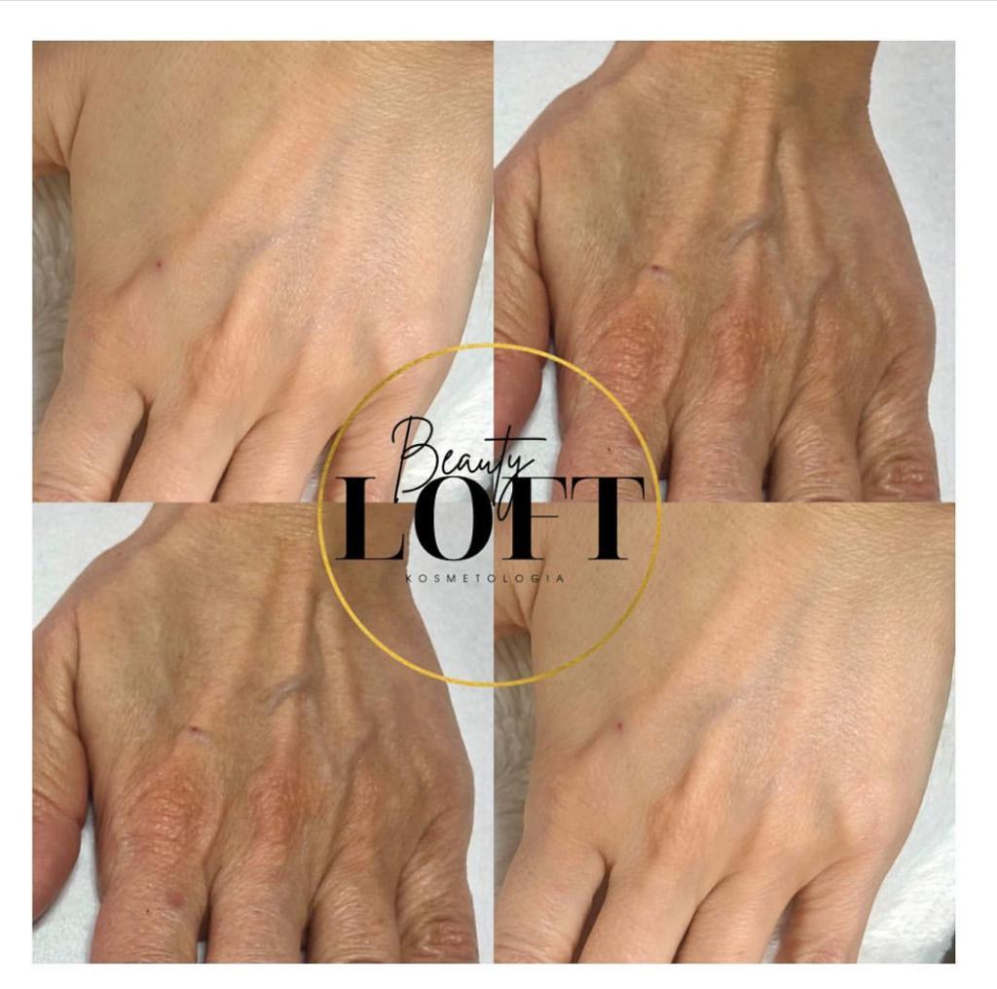
Post treatement results

Slide 20
Thank you for your attention
Certified company
AZIENDA CERTIFICATA
GMP - UNI EN ISO 22716
AZIENDA CERTIFICATA
Medical Device
UNI EN ISO 13485
Headquarter:
Via Figliola, 57
80040 San Sebastiano al Vesuvio – Napoli - ITALY
Tel. (+39) 081 2293463 – (+39) 08142411190
Mobile: +39 349 6193685
e-mail: info@medixasrl.com
www.medixasrl.com
Follow us:
Medixa_srl
Medixa Srl

